Slide 1
The Ark of faith
Rev. Gloria Jun, Pastor

Slide 2
Genesis 6:5-8 (NIV)
⁵ The Lord saw how great the wickedness of the human race had become on the earth, and that every inclination of the thoughts of the human heart was only evil all the time. ⁶ The Lord regretted that he had made human beings on the earth, and his heart was deeply troubled. ⁷ So the Lord said, “I will wipe from the face of the earth the human race I have created—and with them the animals, the birds and the creatures that move along the ground—for I regret that I have made them.” ⁸ But Noah found favor in the eyes of the Lord. ⁹ This is the account of Noah and his family. 9 Noah was a righteous man, blameless among the people of his time, and he walked faithfully with God.

Slide 3
Hebrews 11:4-7 (NIV)
⁴ By faith Abel brought God a better offering than Cain did. By faith he was commended as righteous, when God spoke well of his offerings. And by faith Abel still speaks, even though he is dead.
⁵ By faith Enoch was taken from this life, so that he did not experience death: “He could not be found, because God had taken him away.”^{[a]} For before he was taken, he was commended as one who pleased God. ⁶ And without faith it is impossible to please God, because anyone who comes to him must believe that he exists and that he rewards those who earnestly seek him.
⁷ By faith Noah, when warned about things not yet seen, in holy fear built an ark to save his family. By his faith he condemned the world and became heir of the righteousness that is in keeping with faith.

Slide 4
The Ark of faith

Slide 5
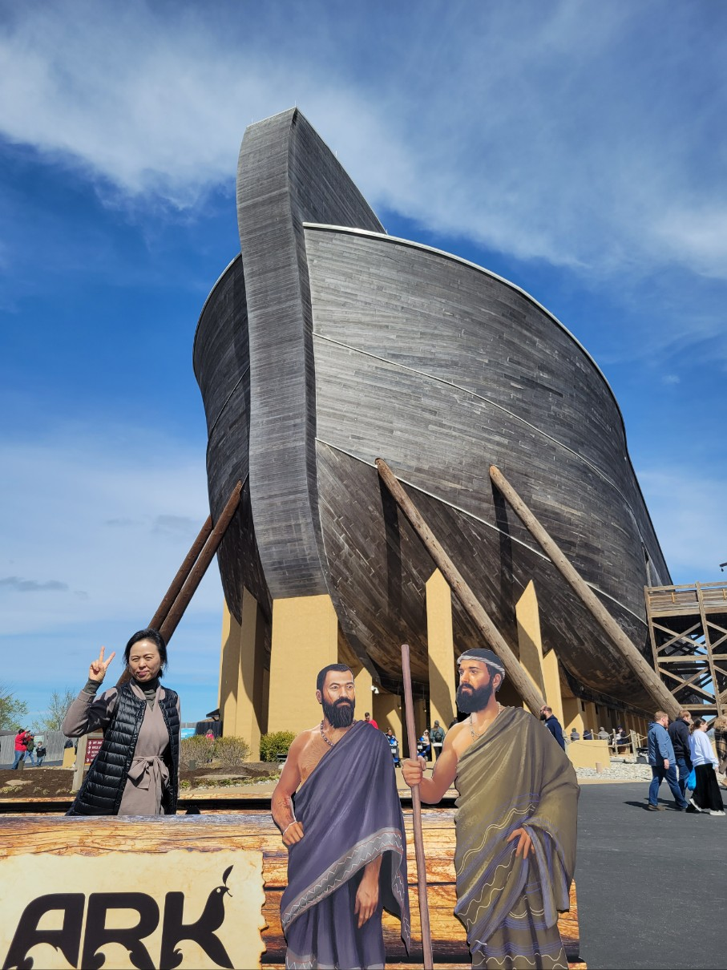
Noah’s ark in Kentucky

Slide 6
Noah’s ark in Kentucky

Slide 7
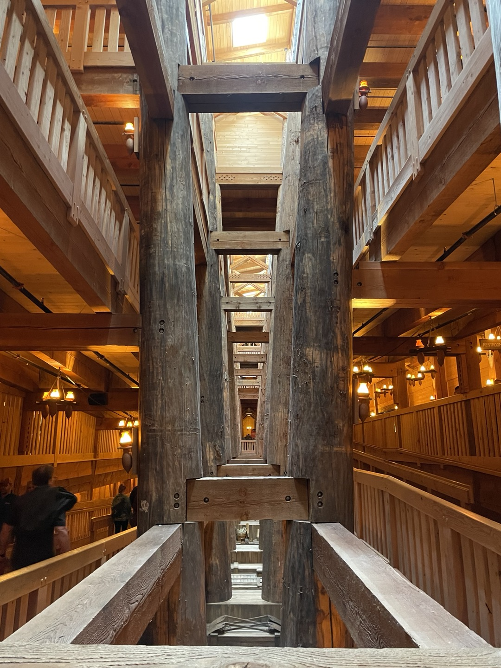
Noah’s ark in Kentucky

Slide 8
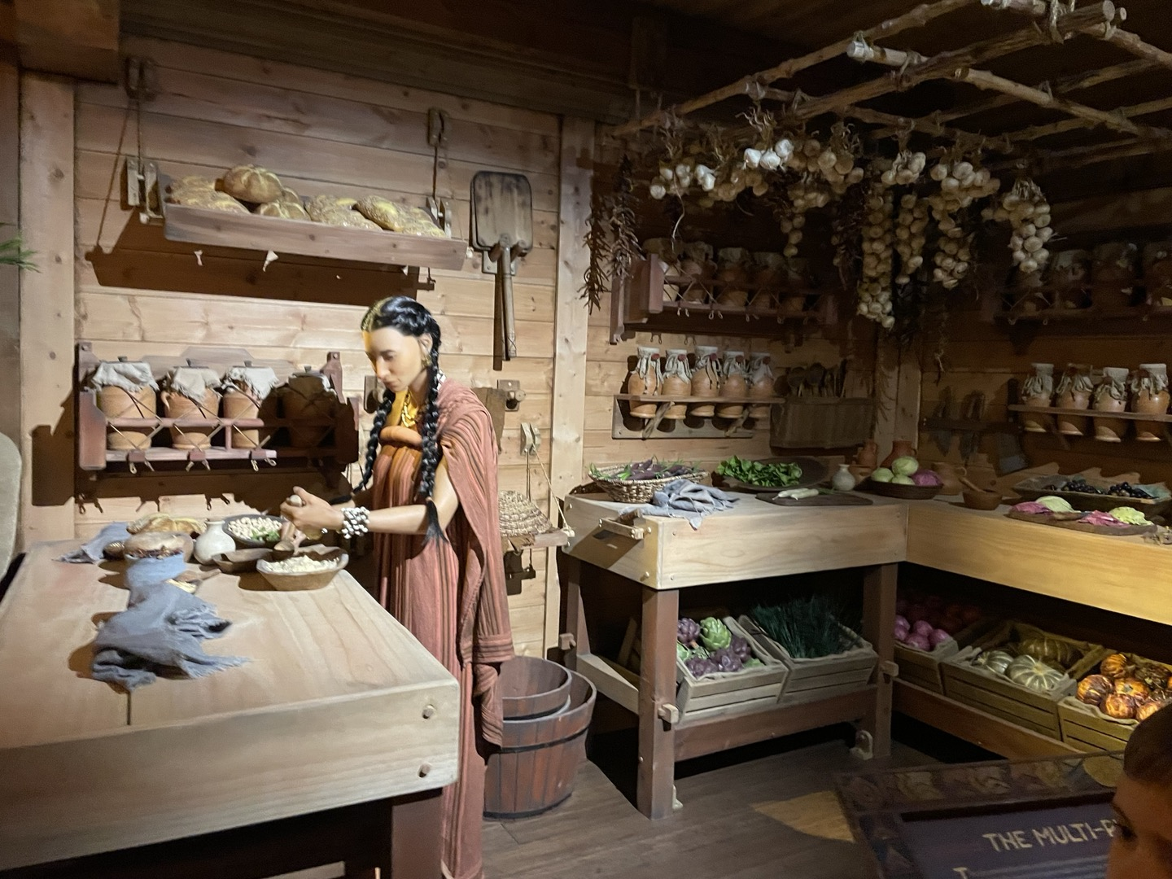
Noah’s ark in Kentucky

Slide 9
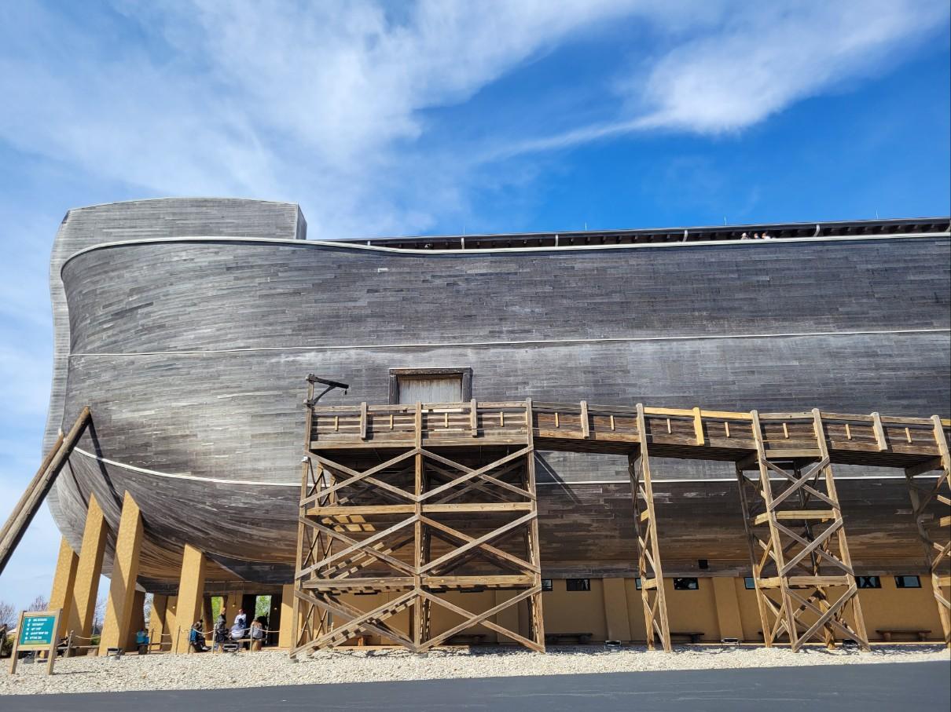
Noah’s ark in Kentucky

Slide 12
Tradin’ my sorrow
Worship & song #3108

Slide 13
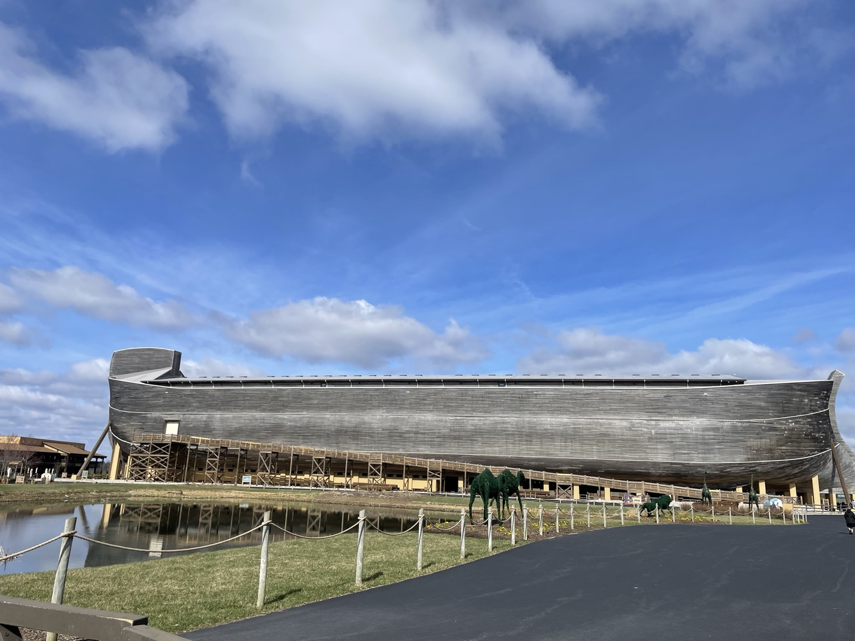
Noah’s ark in Kentucky

Slide 14
Noah’s ark in Kentucky

Slide 15
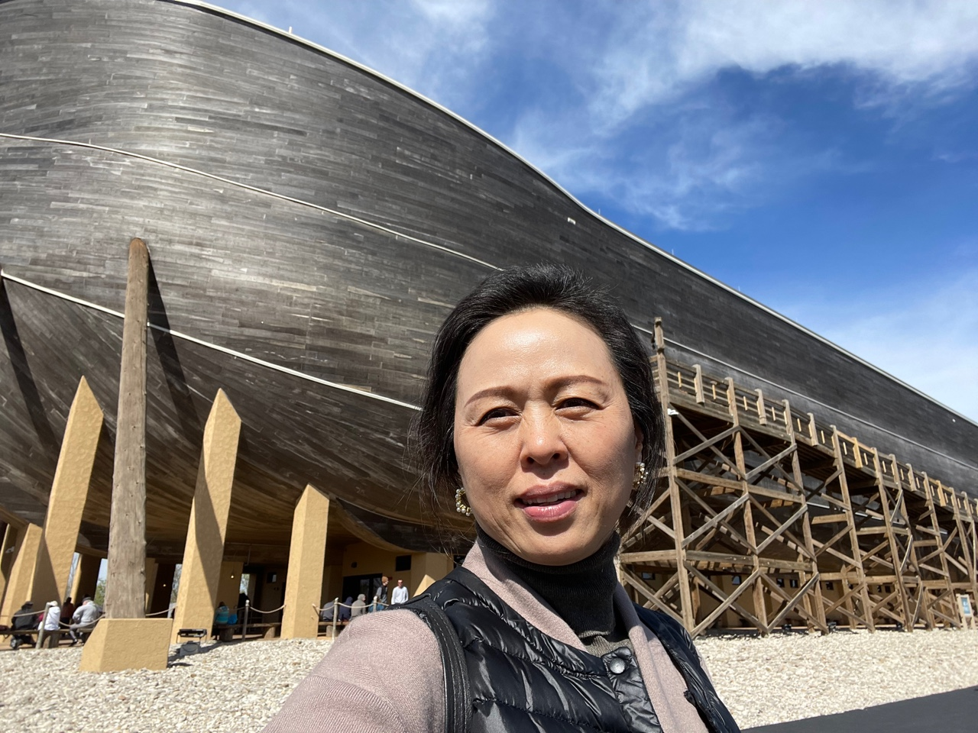
Noah’s ark in Kentucky

Slide 16
Things necessary for our faith
diligence
Perseverance
stability

Slide 17
I will trust in the lord (Hymn #464)
I will trust in the Lord, I will trust in the Lord, I will trust in the Lord, till I die (X2)
Sister, will you trust in the Lord, Sister, will you trust in the Lord, Sister, will you trust in the Lord, till you die (X2)
Brother, will you trust in the Lord, Brother, will you trust in the Lord, Brother, will you trust in the Lord, till you die (X2)
Preacher, will you trust in the Lord, Preacher, will you trust in the Lord, Preacher, will you trust in the Lord, till you die (X2)
I will trust in the Lord, I will trust in the Lord, I will trust in the Lord, till I die (X2)

