Slide 1
Genesis 12:1-4 (NIV)
12 The Lord had said to Abram, “Go from your country, your people and your father’s household to the land I will show you.
² “I will make you into a great nation, and I will bless you;
I will make your name great, and you will be a blessing.^{[a]}
³ I will bless those who bless you, and whoever curses you I will curse;
and all peoples on earth will be blessed through you.”^{[b]}
⁴ So Abram went, as the Lord had told him; and Lot went with him. Abram was seventy-five years old when he set out from Harran.

Slide 2
Hebrews 11:8-16 (NIV)
⁸ By faith Abraham, when called to go to a place he would later receive as his inheritance, obeyed and went, even though he did not know where he was going. ⁹ By faith he made his home in the promised land like a stranger in a foreign country; he lived in tents, as did Isaac and Jacob, who were heirs with him of the same promise. ¹⁰ For he was looking forward to the city with foundations, whose architect and builder is God. ¹¹ And by faith even Sarah, who was past childbearing age, was enabled to bear children because she^{[a]} considered him faithful who had made the promise. ¹² And so from this one man, and he as good as dead, came descendants as numerous as the stars in the sky and as countless as the sand on the seashore.¹³ All these people were still living by faith when they died. They did not receive the things promised; they only saw them and welcomed them from a distance, admitting that they were foreigners and strangers on earth. ¹⁴ People who say such things show that they are looking for a country of their own. ¹⁵ If they had been thinking of the country they had left, they would have had opportunity to return. ¹⁶ Instead, they were longing for a better country—a heavenly one. Therefore God is not ashamed to be called their God, for he has prepared a city for them.

Slide 3
Abraham of Faith and Obedience
Rev. Gloria Jun, Pastor

Slide 4
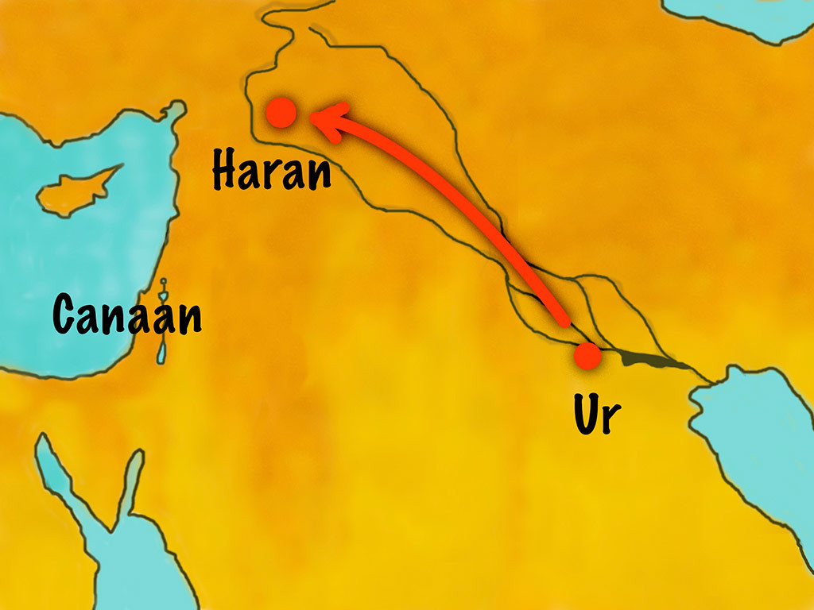
Abram’s Journey

Slide 5
Three Points of Abraham
Abraham’s Calling
Abraham’s Obedience
Abraham’s Faith

Slide 6
What Is Your Call From God?

Slide 7
Only Trust Him (# 337)
Come, every soul by sin oppressed,
there's mercy with the Lord;
and he will surely give you rest,
by trusting in his Word.
Only trust him, only trust him,
only trust him now.
He will save you, he will save you,
he will save you now.

Slide 8
Only Trust Him (# 337)
2. For Jesus shed his precious blood
rich blessings to bestow;
plunge now into the crimson flood
that washes bright as snow.
Only trust him, only trust him,
only trust him now.
He will save you, he will save you,
he will save you now.

Slide 9
Only Trust Him (# 337)
3. Yes, Jesus is the truth the way
that leads you into rest;
believe in him without delay,
and you are fully blest.
Only trust him, only trust him,
only trust him now.
He will save you, he will save you,
he will save you now.

Slide 10
Only Trust Him (# 337)
4. Come then and join this holy band,
and on to glory go,
to dwell in that celestial land
where joys immortal flow.
Only trust him, only trust him,
only trust him now.
He will save you, he will save you,
he will save you now.

Slide 11
Benediction

