Slide 1
Christ, my living water
Rev. Gloria jun

Slide 2
John 4:5-14
New King James Version
⁵ So He came to a city of Samaria which is called Sychar, near the plot of ground that Jacob gave to his son Joseph. ⁶ Now Jacob’s well was there. Jesus therefore, being wearied from His journey, sat thus by the well. It was about the sixth hour.
⁷ A woman of Samaria came to draw water. Jesus said to her, “Give Me a drink.” ⁸ For His disciples had gone away into the city to buy food.
⁹ Then the woman of Samaria said to Him, “How is it that You, being a Jew, ask a drink from me, a Samaritan woman?” For Jews have no dealings with Samaritans.
¹⁰ Jesus answered and said to her, “If you knew the gift of God, and who it is who says to you, ‘Give Me a drink,’ you would have asked Him, and He would have given you living water.”
¹¹ The woman said to Him, “Sir, You have nothing to draw with, and the well is deep. Where then do You get that living water? ¹² Are You greater than our father Jacob, who gave us the well, and drank from it himself, as well as his sons and his livestock?”
¹³ Jesus answered and said to her, “Whoever drinks of this water will thirst again, ¹⁴ but whoever drinks of the water that I shall give him will never thirst. But the water that I shall give him will become in him a fountain of water springing up into everlasting life.”

Slide 3
Christ, my living water
Rev. Gloria jun

Slide 4
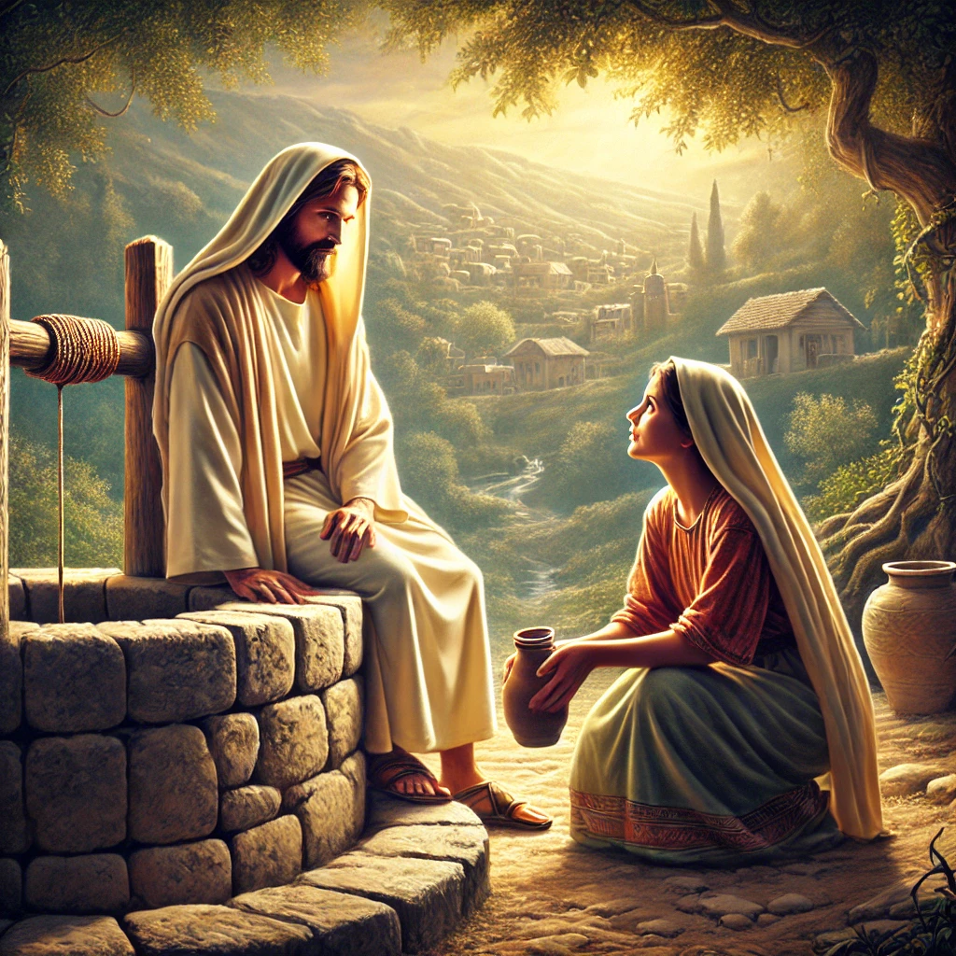

Slide 5
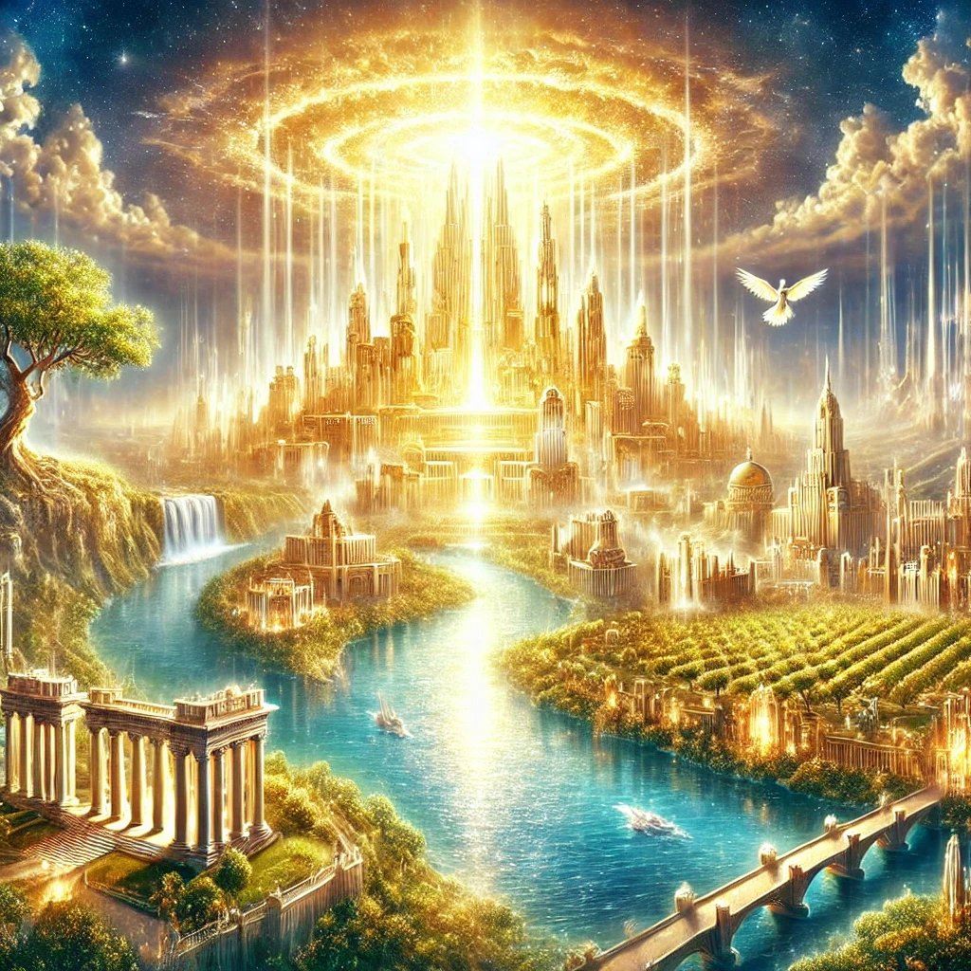

Slide 6
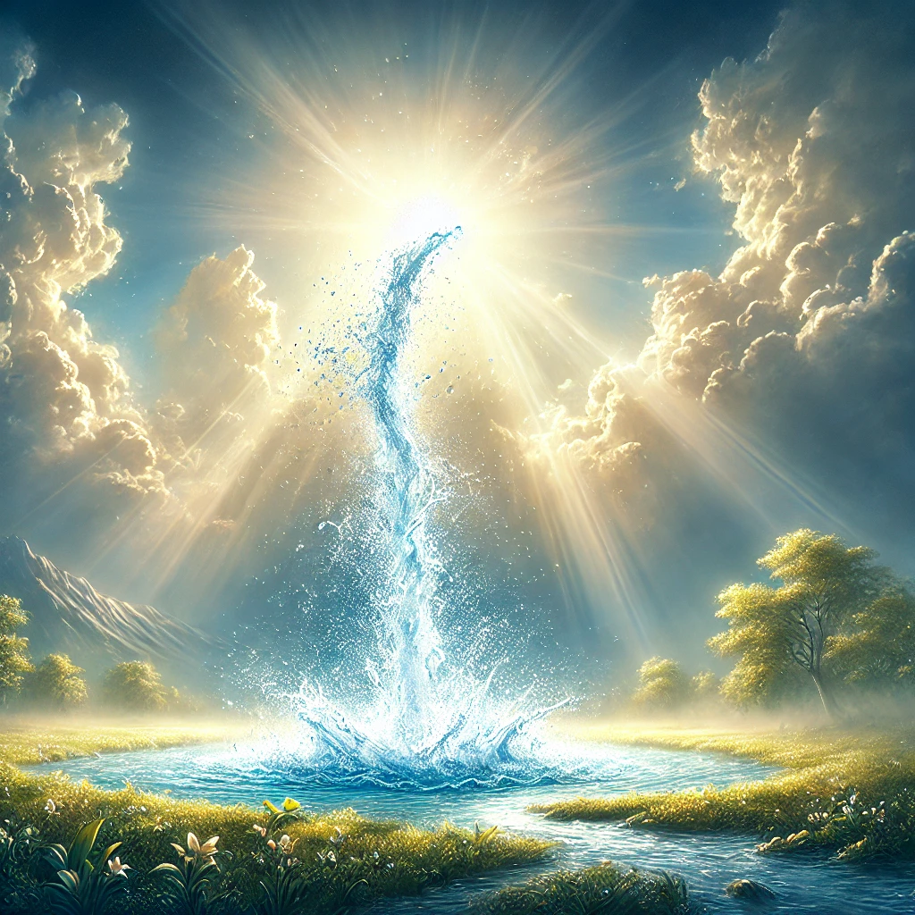
Christ is my living water

Slide 7
My life is in you lord
My life is in You, Lord
My strength is in You, Lord
My hope is in You, Lord
In You, it's in You (2X)
I will praise You with all of my life
I will praise You with all of my strength
With all of my life, with all of my strength
All my hope is in You

