Slide 1
“Life, A gift to Guard”
Rev. Gloria Jun

Slide 2
Psalm 139:13-16
For You formed my inward parts; You covered me in my mother’s womb. ¹⁴ I will praise You, for I am fearfully and wonderfully made; Marvelous are Your works, And that my soul knows very well. ¹⁵ My frame was not hidden from You, When I was made in secret, And skillfully wrought in the lowest parts of the earth. ¹⁶ Your eyes saw my substance, being yet unformed. And in Your book they all were written, The days fashioned for me, When as yet there were none of them.

Slide 3
Memory Verses:
This Week: “I will praise You, for I am fearfully and wonderfully made; marvelous are Your works, and that my soul knows very well.” Psalm 139:14
Last Week: “But Peter and the other apostles answered and said: ‘We ought to obey Godrather than men’” Acts 5:29 (NKJV)

Slide 4
Intro
Happy Mother’s Day!
Mothers endured labor to give life.
Fathers are part of God's design too.
All humans are from Adam—God the Father of all.

Slide 5
Main Point 1: Life is in God’s Image
Genesis 1:27 - Created in His image.
Each human has dignity and worth.
Evolution undermines human value.
God created humans as spiritual beings.

Slide 6
Why Evolution Falls Short
Evolution is not proven fact.
Richard Lewontin & George Wald denied God.
Evolution needs faith too—no clear evidence.

Slide 7
Science Supports the Bible
Examples: Noah’s Ark and Food, Destruction of Sodom and Gomorrah, Red Sea crossing, Jericho’s Walls, Hezekiah’s Tunnel, and People and Plances in Jesus’ time.
Fibonacci sequence in nature shows God’s order: 0,1,1,2,3,5,8,13,21,34…..

Slide 13
Main Point 2: Life Begins Before Birth
Jeremiah 1:5 - Known before the womb.
God loves us before birth.
Bible is pro-life from beginning to end.

Slide 14
Bible Verses Supporting Life
Genesis 25:22 – Two nations in Rebekah’s womb.
Psalm 51:5 – Life formed in iniquity has value.
Psalm 139 – Fearfully and wonderfully made.
Galatians 1 – Paul called from the womb.

Slide 15
Main Point 3: We Must Protect Life
Life belongs to God alone.
Jesus was born despite threats (Herod, society).
Every unborn child bears God’s image.

Slide 16
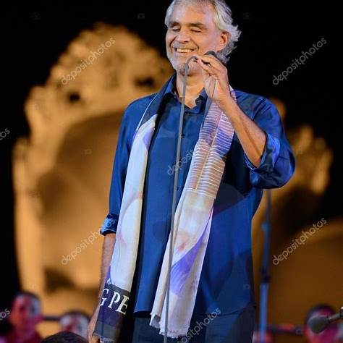
Story: Andrea Bocelli

Slide 17
Abortion is Murder
Exodus 20:13 - 'You shall not murder.'
We must defend the voiceless.
God’s image is in every life.

Slide 18
Our Ministry: Embrace Grace
Support for unexpected pregnant girls, single moms and single dads.
God has affirmed this ministry through providing $5,000 evangelism grant.
Everyone is needed in this mission.

Slide 19
Why We Do This
Life is sacred.
Jesus cared for the weak, the children.
Matthew 25:40 – 'Whatever you did for one of the least …. You did for Me.'

Slide 20
Conclusion
Thank God for mothers who gave and nurtured life.
We are called to value and protect it.

